Slide 1


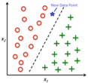

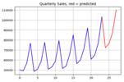
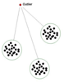




Machine Learning in Azure Cloud
Regression
VM (Virtual Machine)
Machine Learning Studio
Synapse Analytics Studio
Running models in SQL
Power BI
Cognitive Services
Azure Kubernetes Service (AKS), Kubeflow
Azure Cloud
Classification
Forecasting
Anomaly Detection
Recommendation, Ranking

Slide 2
Where and How ML & AI are used ?
ML = Machine Learning
AI = Artificial Intelligence
predictions (predictive analytics, forecasting, trends, investments, elections, sport & weather, news, etc.)
optimization of business processes, reducing costs
extracting information from text, fuzzy deduplication
image and face recognition
recommender systems
detection (anomaly, fraud, crime, terrorism, climate change, etc.)
self-driving cars (planes, boats, drones, construction/rescue machines, etc.)
robots (at home & at work), manufacturing robots
universal language translator, language understanding, concepts learning
music & literature composition, games and math.
medical diagnostics (using genomic, phenotypic, social, etc. data), surgery
intelligent secretary/helper, process management, traffic management
agriculture (pooling weeds, watering, etc.)
toys, military
combining AI with Virtual Reality and 3D printing
effective interface with human brain, greatly expand their cognitive, memory and sensory capabilities, uploading mind into computer
etc. etc. etc.

Slide 3

“AI is the New Electricity”
AI like electricity will also change our lives in many ways which is difficult to predict.
Electricity came into our life ~120 years ago:
- lamps and motors - telegraph, telephone, radio, TV, Internet
- computers, IT, Machine Learning, AI
- finance, trading
- science, education, medical diagnostics
- automation, robotics,
- etc. etc.
Andrew Ng
- co-founded and led Google Brain
- was the chief scientist at Baidu Research (~1,300 people)
for 3 years (2014-2017), resigned in March of 2017.
- adjunct professor at Stanford University
- co-founder and chairman of Coursera
- https://en.wikipedia.org/wiki/Andrew_Ng
- https://www.coursera.org/learn/machine-learning
Artificial Intelligence is the New Electricity
- https://www.facebook.com/andrew.ng.96/videos/1268821713173733/ - https://www.youtube.com/watch?v=21EiKfQYZXc

Slide 4
“AI is Life Extinction Event ?”
“AI - Tsunami ?”

Slide 5
OK, so what is Machine Learning?
- A computer program
- used to describe data in a compressed way
- to make predictions and take actions
- most common ML tasks - regression or classification
Neural Networks (Deep Learning)
Simple Analytics
Standard ML
Classification - learning to label examples based on their features. Model may have ~1-2 thousand of numbers
Logistic Regression
Linear Discriminant Analysis
Support Vector Machines
Decision trees (Random Forest, XGBoost)
etc.
Classification – dog or cat. Model is usually implemented as a Neural Network, and may use up to 175 Bln numbers.
Recognizing images, music, speech
NLP = Natural language Processing
Machine Translation
supervised, unsupervised, reinforcement learning
Generative Models (GANs)
Linear Regression y = f(x) = ax + b
Model uses only two numbers:
a = slope, b = intercept

Slide 6
Artificial General Intelligence (AGI)
AI that could successfully perform any intellectual task that a human can
(Turing test (1950), ...)
Artificial Intelligence (AI)
ML (DL) learning "human" abilities (speech and music recognition, conversation, visual recognition, video prediction, reasoning, self-driving cars, playing games, etc.)
Deep Learning (DL)
ML implemented as Neural Network
Machine Learning (ML)
DS where algorithm learns from data to make predictions
Data Science (DS)
computer skills + statistics
CSV files, SQL, PowerPoint

Slide 7
Machine Learning Systems = Prediction Machines
ML = "Cheap Predictions"
AI = "Cheap Predictions"
Ajay Agrawal
University of Toronto

Slide 8
Recent breakthroughs in DL made it practical
(effective, affordable, and easy).
Instead of software engineers manually coding if/else logic,
DL algorithms can train networks equivalent to ~10s of million of if/else-s.
Distributed ML on Cloud (Google, Microsoft, Amazon, Intel, IBM, etc.)
allow to achieve ~100 Petaflops
(x1000 performance increase in last 3 years).
Prices dropping down precipitously: $6.50/hour per a Google TPU (180 TFlops).
You don't have to build your own infrastructure,
You don't have to code from scratch.
Nowadays you can use variety of pre-trained / pre-configured networks on the cloud.
Compare this with just few years ago:
custom HPC clusters (HPC = High-Performance Computing), low-level C/CUDA coding, etc.

Slide 9
AI in Context
Years
Artificial Intelligence (AI)
ML performing “human” functions
Deep Learning (DL)
ML implemented using multi-layered
structure (Neural Network)
Machine Learning (ML)
DS algorithm learns from data
Data Science (DS)
data + computer/statistics
Reinforcement Learning
alpha-Go
Unsupervised Learning
no labels, Google Translate
Supervised Learning
labeled data
Reasoning,
Inductive & Deductive Logic,
Knowledge Representation,
Ontology
2015
NLP,
Extracting Data from Text
2010
Chatbots,
Conversational
interfaces
Forecasting,
investments,
Resource Mgmnt
2005
Fraud Detection, Security,
Risk Mgmnt
2000
Recommender
Systems
Vision,
Robotics
Amount of data
Compute Speed

Slide 10


Ray Kurzweil, chief engineer for Google and famous futurist stated that "... ultimately, AI will benefit us in the same way that previous technologies have. ... My view is not that AI is going to displace us, ... (but) ... It’s going to enhance us. It does already.”
You need to get into AI asap to be able to surf the new wave, or this wave will drown you.
Ray Kurzweil
Millions of jobs will be "outsourced" to AI.
Also you will see new jobs, like "Chief AI Officer", AI departments.
We already see big shortage in AI specialists. Top AI talent is paid millions of $$.

Slide 11

Azure - VM or DSVM
Linux VM Pricing https://azure.microsoft.com/en-us/pricing/details/virtual-machines/linux/
Azure VM Pricing Comparison https://azureprice.net/?region=eastus2&cores=16,16&ram=0,11400
Azure ML Pricing https://azure.microsoft.com/en-us/pricing/details/machine-learning/
Azure Synapse Analytics Pricing https://azure.microsoft.com/en-us/pricing/details/synapse-analytics/
Managed Disk Pricing https://azure.microsoft.com/en-us/pricing/details/managed-disks/
VM (Virtual Machine) or DSVM (Data Science VM)
They are the same price, but DSVM comes with pre-installed software
(python 3.6.9, sklearn, tensorflow, azureml, etc.)
You get admin rights, can install any tools you need
Can install conda python and any ML libraries you want
Can connect via ssh, can use GitHub
Can work remotely using Jupyter notebooks
Can use local editors with built-in sftp transfer
(BBEdit on Mac, UltraEdit on Windows, etc.)
Can use Azure CLI (Command Line Interface) to manage azure resources and data.
Can use azure python libraries (to move data around, etc.)
Lowest prices are in regions East US 2 or West US 2
Examples of prices for Linux VMs without discounts, "pay-as-you-go":
VM Type | Cores | RAM GB | swap GB | OS disk GB | GPU | $/month | $ for extra 1TB fast SSD
Ddv2 | 2 | 7 | 100 | 14 | - | 101 | 123
Ddv4 | 16 | 64 | 600 | 30 | - | 650 | 123
NC12 Promo | 12 | 112 | 680 | 30 | 2xK80 | 600 | 123
NC12 | 12 | 112 | 680 | 30 | 2xK80 | 1,336 | 123

Slide 12

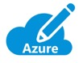





Separate Projects
Azure AD
Users
Groups
Azure
Subscriptions
Resource
Groups
To save money you can "Stop-Deallocate" VM instances when you are not using them.
You can restart at any time, takes ~3 minutes. All disks (except swap) will be preserved.
You can use AD and resource groups to safely separate projects.
Blob
Resources
P:
Disk
P:
Disk
S:
Disk

Slide 13
Azure Machine Learning
Machine Learning Workspace – set of tools for ML
Azure Machine Learning Studio:
Linux VMs (single or clusters)
ML Studio notebooks
Jupyter notebooks, or Jupyter Lab, or R studio
python scripts (or R) – can run in terminal
data storage access
AutoML (regression, classification, forecasting)
automating experiments and whole ML workflows (manually or from scripts): .. create datasets (data containers) .. models (model containers) .. pipelines (executable flow) .. endpoints (web or for batch) .. experiments - submitted pipeline
Azure ML : https://ml.azure.com
Login into https://portal.azure.com
Move mouse to top-right and click on your icon (sign-in/sign-out) and select a directory (you may have several).
Then select subscription
Then go to Machine Learning workspace (can search for it, or it is in the list, you may have several ML workspaces) - https://ml.azure.com/selectWorkspace
One in ML workspace, find and click the url to Azure Machine Learning Studio.
Here you can work with python notebooks, etc.
Note:
"Classic" is the older version of Azure ML Studio
where there is no Jupyter notebook.
You can only drag & drop pieces.
It is basically the "Designer" part of the new ML Studio.

Slide 14
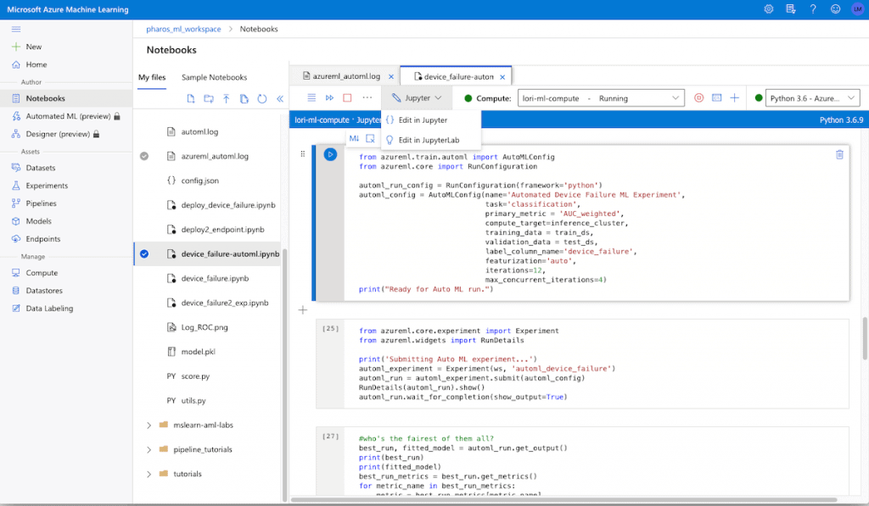
Machine Learning Studio
Multiple tabs with notebooks and scripts
Author:
Notebooks
AutoML
Designer
Assets:
Datasets
Experiments
Pipelines
Models
Endpoints
Manage:
Compute
Datastores
Data Labeling

Slide 15
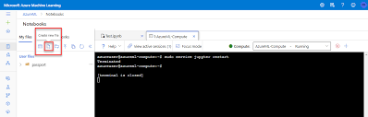
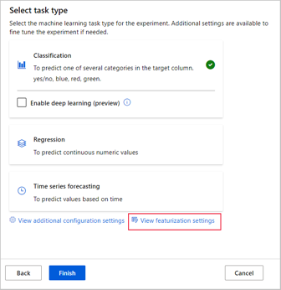
Machine Learning Studio - continued
Running scripts from unix terminal
Selecting AutoML Type
AutoML can run ~200 models and select the best one for you.
You create AutoML by going through a set of screens
where you can select the type of the model
(Classification, Regression, Time series forecasting), selecting the data (features and target),
types of features (categorical, ...),
narrow down types of models, etc.

Slide 16
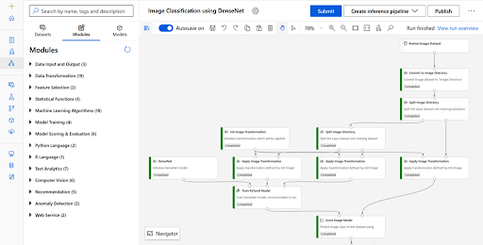
Machine Learning Studio - continued
Simple pipeline
to run python script with custom modules
Datasets
Sample datasets
Data Input and Output
Data Transformation
Feature Selection
Statistical Functions
Machine Learning Algorithms
Model Training
Model Scoring & Evaluation
Python Language
R Language
Text Analytics
Computer Vision
Recommendation
Anomaly Detection
Web Service
Complex pipeline

Slide 17
Machine Learning Studio - continued
Jupyter Notebook or Jupyter Lab
R-Studio

Slide 18
Machine Learning Studio - continued
Running Experiments

Slide 19
Machine Learning Studio - authentication
To run ML jobs you need to authenticate
using one of three main methods:
Interactive – per-user authentication during experimentation and iterative development. Can prompt user to authenticate.
Service principal – non-human account to run your jobs automatically. Need name/password (called "clientId" and "clientSecret") - https://docs.microsoft.com/en-us/azure/machine-learning/how-to-setup-authentication#configure-a-service-principal
Managed identity – used when using ML SDK on Azure VM or cluster. Allows to connect to workspace without storing credentials in Python code or prompting the user to authenticate
Example: Service principal authentication in python script:
from azureml.core.authentication import InteractiveLoginAuthentication
from azureml.core.workspace import Workspace
from azureml.core.authentication import ServicePrincipalAuthentication
# interactive_auth = InteractiveLoginAuthentication(tenant_id = "your-ad-tenant-id")
sp = ServicePrincipalAuthentication(
tenant_id="your-ad-tenant-id",
service_principal_id="clientId",
service_principal_password="clientSecret"
)
# load existing worksapce
bag.ws = Workspace.get(name='your-ml-workspace-name',
auth=sp,
subscription_id='your-subscription-name',
resource_group='your-resource-group-name'
)

Slide 20
Azure ML : Some Links
Very good youtube video "Train and deploy ML models at scale using Azure Machine Learning | INT134C" -
- https://www.youtube.com/watch?v=2OgBxYCnVGk
And here is the link from this video to a good 10-hrs course:
"Build AI solutions with Azure Machine Learning" - https://docs.microsoft.com/en-us/learn/paths/build-ai-solutions-with-azure-ml-service/
Yet another good tutorial: "Creating End-to-End MLOps pipelines" - https://benalexkeen.com/creating-end-to-end-mlops-pipelines-using-azure-ml-and-azure-pipelines-part-1/
Machine Learning Workshop: - https://github.com/microsoft/MCW-Machine-Learning
ML Ops Workshop: - https://github.com/microsoft/MCW-ML-Ops
Also:
https://docs.microsoft.com/en-us/azure/machine-learning/
https://docs.microsoft.com/en-us/azure/machine-learning/tutorial-pipeline-batch-scoring-classification
https://azure.microsoft.com/en-us/blog/retraining-and-updating-azure-machine-learning-models-with-azure-data-factory/
https://azure.microsoft.com/en-us/blog/azure-data-factory-updates-integration-with-azure-machine-learning-2/
https://docs.microsoft.com/en-us/azure///data-factory/transform-data-machine-learning-service
Pipelines - https://www.youtube.com/watch?v=lVP7ywRq8p4
Old (2016) video about calling ML from Azure Data Factory - https://www.youtube.com/watch?v=7k4XvM4wd0k
Azure ML Pricing - https://azure.microsoft.com/en-us/pricing/details/machine-learning/
Here is a very good post on training using sklearn – and then register the model in ML Studio:
https://towardsdatascience.com/deploying-ml-models-on-azure-a948c106f7b5
or https://ai.plainenglish.io/deploying-ml-models-on-azure-8daa9c10db5a
This above tutorial doesn't actually "deploy" the model.
The more appropriate title should be "Register your custom python model in ML Studio"
Note the use of library "joblib" to store the model into pickle (and to retrieve it).
from sklearn.externals import joblib
joblib.dump(value=mymodel, filename="mymodel.pkl")
and then:
from azureml.core.model import Model
model = Model.register(
workspace=ws,
model_path="mymodel.pkl",
model_name="boston_housing_lr")
Then you can use the second tutorial on how to deploy the model:
https://docs.microsoft.com/en-us/azure/machine-learning/how-to-deploy-and-where
For this deployment you will need to write the "entry script" with methods init() and run()
Once you have this script, you can go to your models (in ML Studio),
click on your model, then click on "Deploy" on top,
fill-in parameters (name, ... , entry script, ...) - and click the button to deploy it.
Another (simpler) way to deploy the model is to create a ML pipeline with the python script,
and then execute it from ADF (Azure Data Factory):
https://docs.microsoft.com/en-us/azure/data-factory/transform-data-machine-learning-service

Slide 21
Azure ML : More Links
Google-ing mount datastore azure ml notebook -
- https://github.com/microsoft/MLOpsPython -
- https://docs.microsoft.com/en-us/python/api/azureml-core/azureml.core.datastore?view=azure-ml-py -
Develop for Azure Files with Python -
- https://docs.microsoft.com/en-us/azure/storage/files/storage-python-how-to-use-file-storage -
Azure for Python Developers -
- https://docs.microsoft.com/en-us/azure/developer/python/ -
Azure REST API Reference -
- https://docs.microsoft.com/en-us/rest/api/azure/ -
Azure SDK for Python -
- https://github.com/Azure/azure-sdk-for-python/tree/master/sdk/storage -
- https://docs.microsoft.com/en-us/python/api/overview/azure/ml/?view=azure-ml-py -
Azure SDK – trigger published pipeline -
- https://docs.microsoft.com/en-us/azure/machine-learning/how-to-trigger-published-pipeline#trigger-pipelines-with-azure-machine-learning-sdk-for-python –
Automate ML Experiments
- https://docs.microsoft.com/en-us/azure/machine-learning/how-to-use-automlstep-in-pipelines -
- https://towardsdatascience.com/hidden-tricks-for-running-automl-experiment-from-azure-machine-learning-sdk-915d4e3f840e -
Understand AutoML
- https://docs.microsoft.com/en-us/azure/machine-learning/how-to-understand-automated-ml#regressionforecasting-metrics -
- https://docs.microsoft.com/en-us/azure/machine-learning/how-to-configure-auto-train#primary-metric -
What is Automated ML
- https://docs.microsoft.com/en-us/azure/machine-learning/concept-automated-ml -
Many Models Solution Accelerator
- https://github.com/microsoft/solution-accelerator-many-models -
Configure automated ML experiments in Python: - https://docs.microsoft.com/en-us/azure/machine-learning/how-to-configure-auto-train -

Slide 22
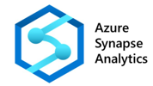



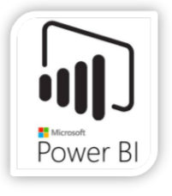
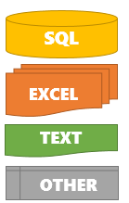




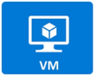

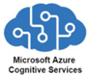

Azure Synapse
Azure Data Lake (Files in Blob Storage)
Synapse
Integrate
Streaming Data
SQL
Data Pipelines
Serverless
and Dedicated SQL Pools
Pre-aggregated Data
Distributed Parallel Data Processing, Machine Learning
Machine Learning
Web End-Points

Slide 23

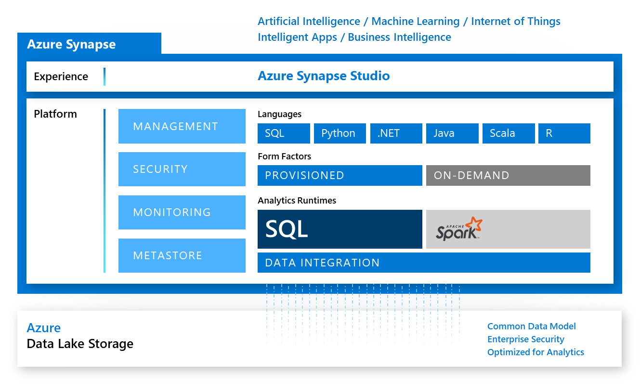
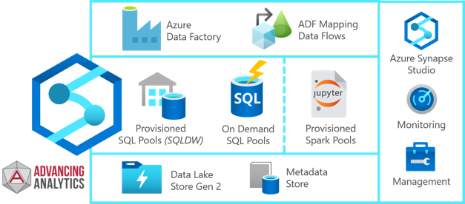
Azure Synapse Analytics
Azure Synapse Workspace – newest collection of Azure tools for Analytics - https://azure.microsoft.com/en-us/services/synapse-analytics/
Azure Storage Gen 2 substitutes for Storage Gen1 and Data Lake Gen 1. Gen 2 is more reliable, efficient, cheaper, supports Big Data
Data pools (Serverless, Dedicated, Spark). Dedicated SQL Pool = SQL DataWarehouse You can query csv, jason, parquet files - serverless SQL pools
Compute clusters – including Spark
Data Factory – to automate data flows
Azure Synapse Link for Azure Cosmos DB https://docs.microsoft.com/en-us/azure/cosmos-db/synapse-link
Cosmos DB Analytical Store https://docs.microsoft.com/en-us/azure/cosmos-db/analytical-store-introduction
Power BI Integration

Slide 24


Synapse - Always Clusters = Pools
(for parallel processing)
SQL
SQL
SQL
Spark
Spark
Spark
SQL Engine
SQL Pools
(Dedicated & Serveless)
Spark Engine
Spark Pools
PySpark
Note: Databricks can also be used as part of Synapse Integrate pipelines, although it is not part of Synapse Studio

Slide 25
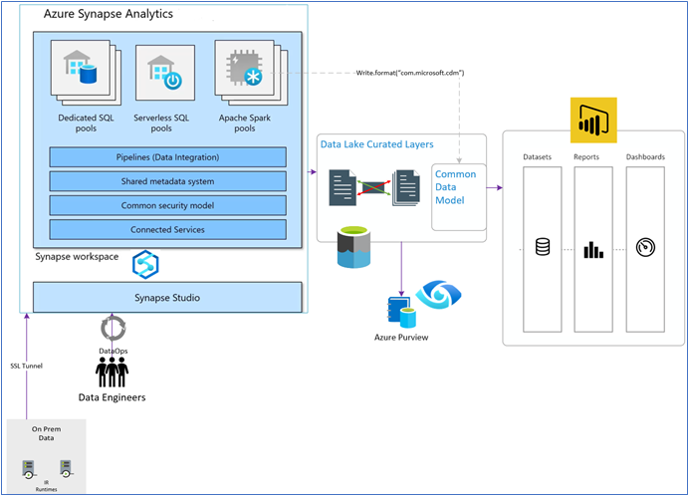

Slide 26


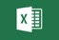



Common ML Architecture (migrating data from AWS)
Ingest
Store
Prep and train
Load and Serve
Analyze
Use Visual Studio SSAS project
or SSIS to retrieve the Cube(s)
Azure Synapse Analytics
Integrate
Prepare Data for ML
Pull from S3
Cube(s) in CSV
Azure Data Lake Store
shaped data
Predicted results
AWS S3 Bucket
Azure Data Factory
Azure Auto ML
Synapse SQL
Power BI

Slide 27
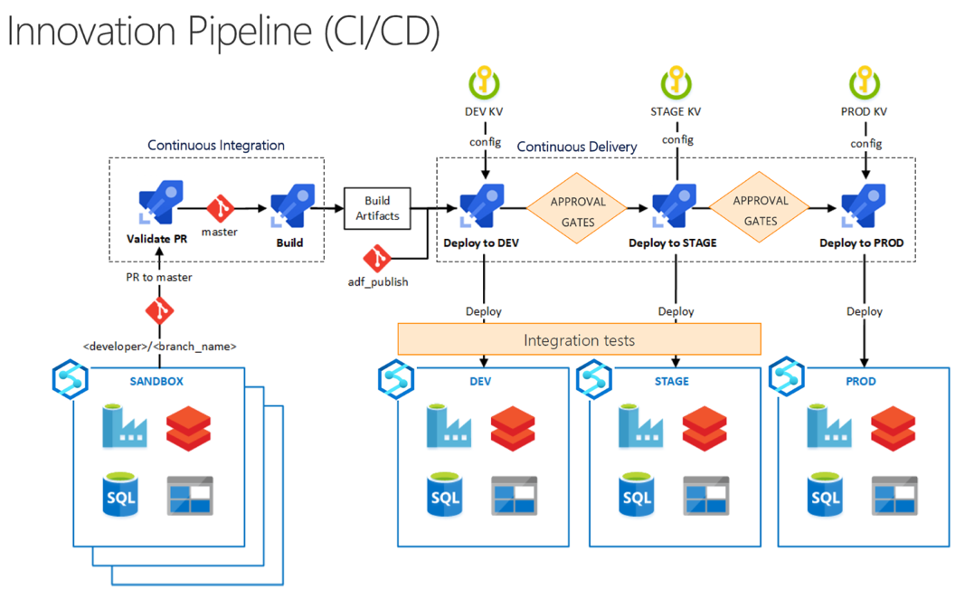

Slide 28
Create Synapse Analytics Workspace
Then click on "Open Synapse Studio

Slide 29
Synapse Analytics Studio
SQL script
Notebook
Data flow
Apache Spark job
pipeline
copy data

Slide 30
Synapse Notebook
You can run different languages – Python, SQL, Scala, etc.
Over a compute cluster – easy to resize as needed.
(shuts down after some idle time you specify).

Slide 31
Each Notebook Gets Its Own Cluster
Notebook "Lev1" is running
Second notebook can't re-use the same cluster

Slide 32
PySpark Notebook – like Jupyter Notebook
similar to Jupyter notebook, provides inline help
can use regular python (current version 3.6.9)
can use azureml libraries, sklearn libraries, matplotlib, seaborn, etc.
can use spark/pyspark and MLlib libraries - https://spark.apache.org/docs/latest/

Slide 33
Synapse Spark vs DataBricks
 | Databricks | Synapse Spark
Spark | very fast Runtime can use GPU-clusters standard/high-concurrency | Open-source Apache Spark support for .NET
Notebooks | Databricks Notebooks Real-time co-authoring Automated versioning | Nteract Notebooks Has co-authoring of Notebooks, but one person needs to save the Notebook before another person sees the change. Doesn’t have automated versioning
Access Data Lake | You need to mount a data lake before using it | When creating Synapse, you can select your primary D.L.
Delta | Databricks Delta has extra optimizations - https://docs.microsoft.com/en-us/azure/databricks/delta/ Delta Lake is a storage layer that brings scalable, ACID transactions to Apache Spark and other big-data engines | Delta Lake is open source - https://docs.microsoft.com/en-us/azure/synapse-analytics/spark/apache-spark-what-is-delta-lake - https://github.com/delta-io/delta
Not the same | Is not a data warehouse tool but rather a Spark-based notebook tool Has a focus on Spark, Delta Engine, MLflow (open source platform to manage the ML lifecycle) and MLR (Machine Learning in R) | Has both a traditional SQL engine as well as a Spark engine Is a data warehouse (i.e. Synapse Analytics) + an interface tool (i.e. Synapse Studio)
Developer Experience | Databricks UI, Databricks Connect (i.e. remote connect from Visual Studio Code, Pycharm, etc.) and soon Jupyter & RStudio UI within Databricks | Spark-development only through Synapse Studio (not through local IDEs) Doesn’t have Git yet integrated within the Synapse Studio Notebooks
Accessing Databricks Delta-Lake from Synapse
https://giangnt2.medium.com/directly-reading-delta-lake-data-from-azure-synapse-8b911dce2bcd
https://mrpaulandrew.com/2021/01/21/how-interchangeable-are-delta-tables-between-azure-databricks-and-azure-synapse-analytics/

Slide 34
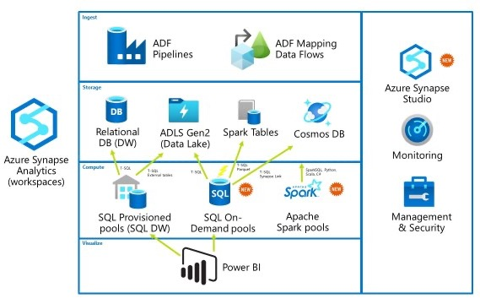
Synapse Pools
Spark Pools
SQL Pools: .. Dedicated SQL Pool ( formerly SQL DW ) .. Serverless Pool (on-demand, use SQL to query files, databases, or Spark Tables

Slide 35
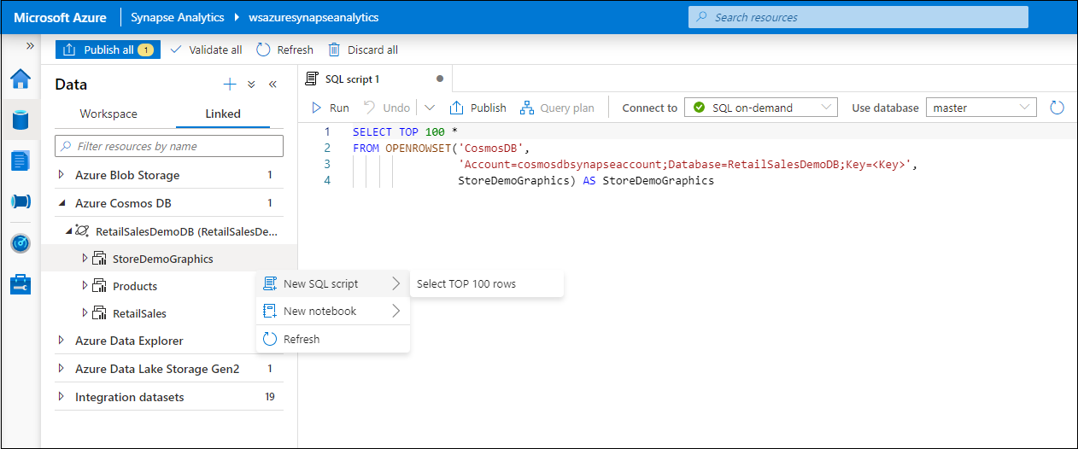
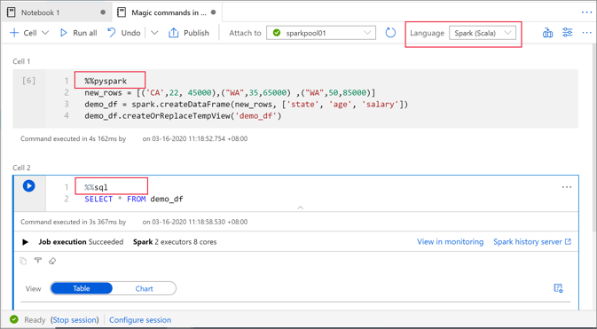
Synapse SQL
Query from Data Source
Query from Notebook using pyspark or SQL
Synapse Notebooks:
https://docs.microsoft.com/en-us/azure/synapse-analytics/spark/apache-spark-development-using-notebooks?tabs=classical
Table or Chart Output

Slide 36
Synapse SQL Scripts
Example of SQL Query
from CSV files in Blob Storage

Slide 37
Synapse – getting link to a file in Blob Storage for SQL
Locate the file in Blob storage
Right-click on it and select "Select top 100 rows"
You will get an SQL you can copy and use

Slide 38
Synapse Integrate
Creating Data Pipelines
Move and Process data
Examples:
Synapse Notebook
Synapse Spark job definition
Synapse SQL pool stored procedure
Databricks Notebook
Databricks Jar
Databricks Python
Machine Learning Batch Execution
Machine Learning Update Resource
Machine Learning Execute Pipeline
- https://docs.microsoft.com/en-us/azure/data-factory/
- https://docs.microsoft.com/en-us/azure/data-factory/transform-data-databricks-notebook
- https://docs.microsoft.com/en-us/azure/data-factory/transform-data-databricks-jar
- https://docs.microsoft.com/en-us/azure/data-factory/transform-data-databricks-python
- https://docs.microsoft.com/en-us/azure/data-factory/transform-data-using-machine-learning
- https://docs.microsoft.com/en-us/azure/data-factory/update-machine-learning-models
- https://docs.microsoft.com/en-us/azure/data-factory/transform-data-machine-learning-service

Slide 39
Azure Synapse Pricing and Docs
Azure Synapse Pricing
https://azure.microsoft.com/en-us/pricing/details/synapse-analytics/
Azure Synapse Documentation:
https://docs.microsoft.com/en-us/azure/synapse-analytics/
Good one-page tutorial on using pyspark notebook:
https://docs.microsoft.com/en-us/azure/synapse-analytics/spark/apache-spark-development-using-notebooks
Sample notebooks:
https://github.com/Azure-Samples/Synapse/tree/main/Notebooks
Visualize data
https://docs.microsoft.com/en-us/azure/synapse-analytics/spark/apache-spark-data-visualization-tutorial
Apache Spark:
https://en.wikipedia.org/wiki/Apache_Spark
Accessing files in Azure Gen2 storage:
https://github.com/Azure-Samples/Synapse/blob/main/Notebooks/PySpark/01%20Read%20and%20write%20data%20from%20Azure%20Data%20Lake%20Storage%20Gen2.ipynb

Slide 40
Azure Synapse Analytics and AI
Tutorial and Lab (step-by-step)
- https://github.com/microsoft/MCW-Azure-Synapse-Analytics-and-AI
- https://github.com/microsoft/MCW-Azure-Synapse-Analytics-and-AI/blob/master/Hands-on%20lab/HOL%20step-by%20step%20-%20Azure%20Synapse%20Analytics%20and%20AI.md
Note: MSFT provides this as Free training – you need to get credentials from them,
log-in to the Azure portal https://portal.azure.com/ with provided credentials.
Note - use incognito mode in Chrome, allow all cookies, stop all ad-blockers.
Notes: Three similar serverless solutions:
Azure Serverless,
Google BigQuery
AWS Athena
Best practices for serverless SQL pool: - https://docs.microsoft.com/en-us/azure/synapse-analytics/sql/best-practices-sql-on-demand
Capacity limits for dedicated SQL pool in Azure Synapse Analytics: - https://docs.microsoft.com/en-us/azure/synapse-analytics/sql-data-warehouse/sql-data-warehouse-service-capacity-limits
REST APIs for dedicated SQL pool (formerly SQL DW) in Azure Synapse Analytics: - https://docs.microsoft.com/en-us/azure/synapse-analytics/sql-data-warehouse/sql-data-warehouse-manage-compute-rest-api
Azure Machine Learning Tutorials:
- https://github.com/Azure/MachineLearningNotebooks/tree/master/tutorials -

Slide 41
Running Models from SQL or Power BI
-----------------------------------------------------------
-- Sample table schema for storing a model and related data
CREATE TABLE [dbo].[Models]
(
[Id] [int] IDENTITY(1,1) NOT NULL,
[Model] [varbinary](max) NULL,
[Description] [varchar](200) NULL
)
WITH
(
DISTRIBUTION = ROUND_ROBIN,
HEAP
)
GO
-----------------------------------------------------------
-- Copy command to load hexadecimal string of the model
-- from Azure Data Lake storage location
COPY INTO [Models] (Model)
FROM '<enter your storage location>'
WITH (
FILE_TYPE = 'CSV',
CREDENTIAL=(IDENTITY='access-id', SECRET='storage-key')
)
-----------------------------------------------------------
-- Query for ML predictions
SELECT d.*, p.Score
FROM PREDICT(
MODEL = (SELECT Model FROM Models WHERE Id = 1),
DATA = dbo.mytable AS d,
RUNTIME = ONNX)
WITH (Score float) AS p;
Trained Model can be registered in SQL as a function !
Recommended approach:
pickle file of the model,
convert to ONNX (onnx.ai - Open Neural Network Exchange)
use it from SQL server: - https://docs.microsoft.com/en-us/azure/synapse-analytics/sql-data-warehouse/sql-data-warehouse-predict
Alternatively:
create a stored procedure to get the data,
and then invoke model via cursor
Also the model may be invoked via REST API endpoint.
Invoke model from PowerBI:
- https://github.com/alex-nogue/Machine_Learning_in_Power_BI#invoke-a-model-in-power-bi-using-azure-ml-service
Three Ways to Run ML on SQL Server
ML Service
native PREDICT
Remote Compute Context
- https://tsmatz.wordpress.com/2018/03/02/patterns-sql-server-machine-learning-services-r-and-python/

Slide 42
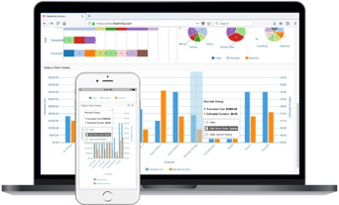


Typical Data Organization for Analytics
DB
Queries
Files
Results
OLAP database with columnar storage for fast and flexible querying (a.k.a. Analytical Store).
Interactive
Dashboards
(Power BI)
Rise and Fall of the OLAP Cubes:
https://www.holistics.io/blog/the-rise-and-fall-of-the-olap-cube/

Slide 43
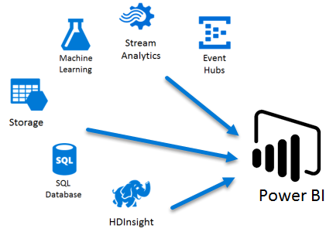
Synapse – Simplified Architecture for Analytics
(no intermediate analytical store)
Synapse SQL
Pools
Power BI
in Azure
Microsoft Power BI on Azure
- https://azure.microsoft.com/en-us/services/developer-tools/power-bi/
- https://powerbi.microsoft.com/en-us/

Slide 44

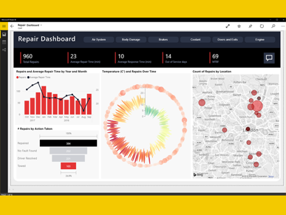
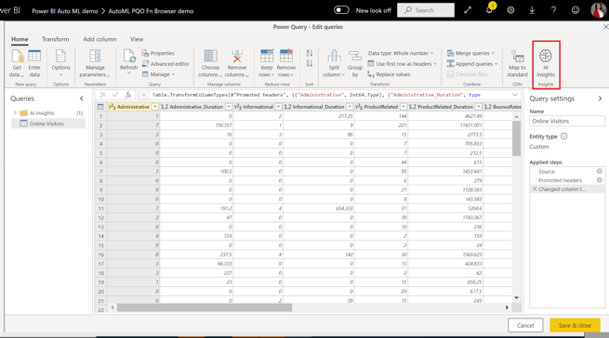
Power BI
No-code ML in Power BI is similar to AutoML
in Azure ML Studio
Tutorial: Build a Machine Learning model in Power BI
- https://docs.microsoft.com/en-us/power-bi/connect-data/service-tutorial-build-machine-learning-model
Create a dataflow with the input data
Create and train a machine learning model
Review the model validation report
Apply the model to a dataflow entity
Using the scored output from the model in a Power BI report

Slide 45
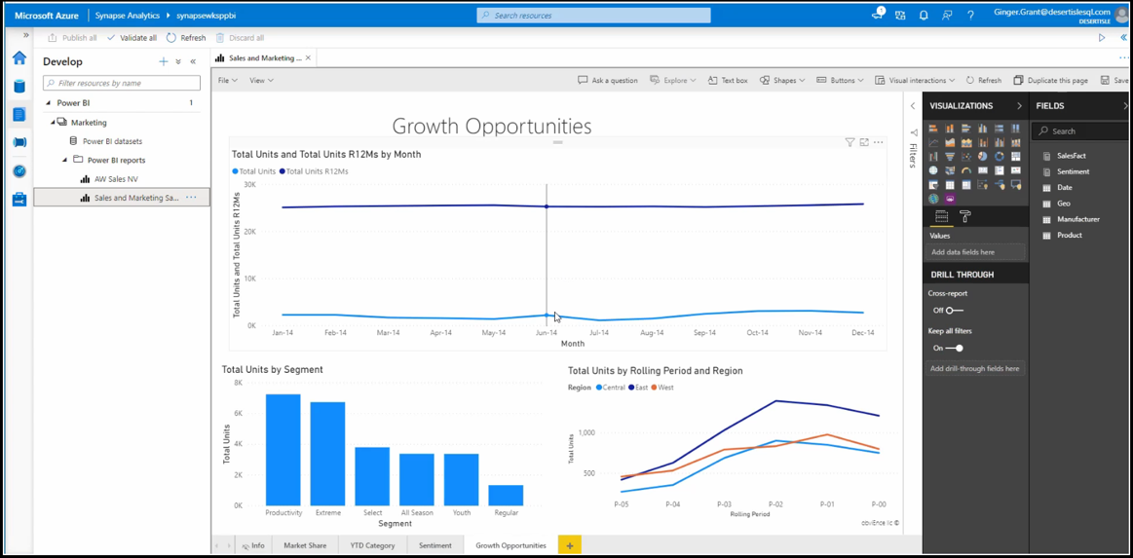
Linking to Power BI from within Azure Synapse
Tutorial: https://docs.microsoft.com/en-us/azure/synapse-analytics/get-started-visualize-power-bi

Slide 46

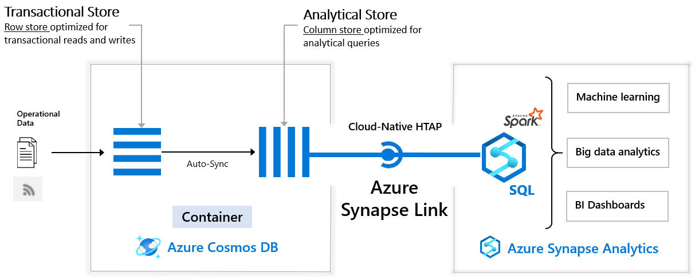
Cosmos DB – Synapse Integration
Azure Cosmos DB:
fast NoSQL multi-model database (key-value, documents, graphs and columnar)
low order-of-millisecond response times
global scaling
- https://docs.microsoft.com/en-us/azure/cosmos-db/use-cases
- https://docs.microsoft.com/en-us/azure/cosmos-db/synapse-link

Slide 47
More Links:
Visual Studio Code – good editor:
- https://code.visualstudio.com/
Download Integration Runtime:
- https://www.microsoft.com/en-us/download/details.aspx?id=39717 -
Download AZCopy:
- https://docs.microsoft.com/en-us/azure/storage/common/storage-use-azcopy-v10 -
AZCopy Documentation:
- https://docs.microsoft.com/en-us/azure/storage/common/storage-ref-azcopy-copy -
Transfer S3 using AzCopy:
- https://docs.microsoft.com/en-us/azure/storage/common/storage-use-azcopy-s3 -
Differences between Standard and Premium storage:
- https://www.danielstocker.net/what-is-the-difference-between-azure-standard-storage-and-azure-premium-storage/ -
-

Slide 48
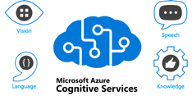
Azure Cognitive Services
1. Vision
Image analysis and anotation
Handwriting recognition
Celebrity and landmark recognition in pictures
Read the text in images
Analyze videos in real-time (text-based descriptions)
2. Speech
Speech recognition and speech-to-text transcriptions
Text-to-speech transcriptions
Real-time translations
Speaker verification (Id a person by analyzing speech)
3. Language
Text Analytics API - key phrases, languages, sentiment, and interlinking
Bing spell check (proofreading)
Translator text
Content moderator (images, text)
4. Knowledge
Q&A maker (build FAQ)
5. Search
Bing web search
Bing custom search (filter, safety, etc.)
Bing video search
Bing image search
Bing news search
Ready-to-use AI Solutions
No Machine-Learning expertise required
Use API call to embed the ability to see, hear, speak, search, or understand into your process
Accelerate decision-making in your apps
4-12% cheaper than comparable services in AWS
- https://docs.microsoft.com/en-us/azure/cognitive-services/what-are-cognitive-services
- https://docs.microsoft.com/en-us/azure/cognitive-services/
Pros - easy to use, high quality services
Cons – may be costly depending on data volume

Slide 49
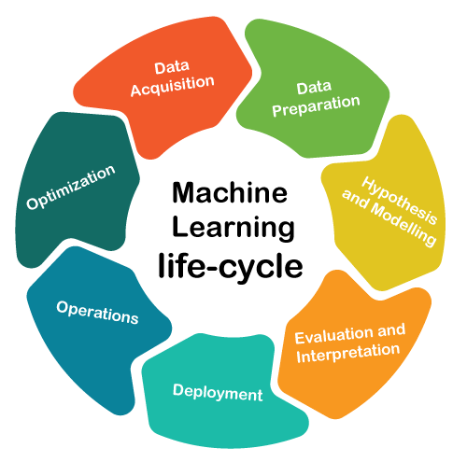
Machine Learning Architectures
Nice Review about MLOps Reference Architectures
https://medium.com/dataseries/machine-learning-reference-architectures-from-google-facebook-uber-databricks-and-others-58191cf82b98
The lifecycle of Machine Learning solutions is
fundamentally different than other software disciplines,
because the deployed model needs to be constantly
re-trained and optimized.

Slide 50

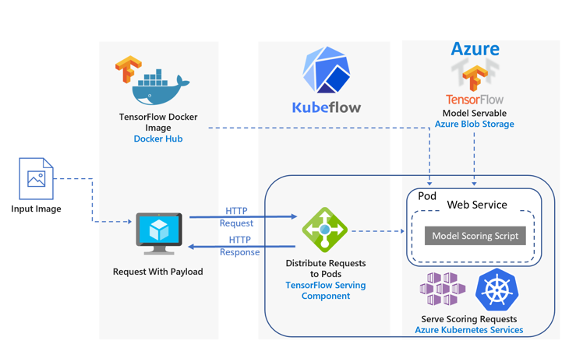
Kubeflow
Azure ML:
https://docs.microsoft.com/en-us/azure/machine-learning/overview-what-is-azure-ml
Kubeflow:
Azure Kubernetes Service (AKS) - https://azure.microsoft.com/en-us/services/kubernetes-service/
Kubeflow - https://www.kubeflow.org/
Kubeflow on Azure - https://www.kubeflow.org/docs/distributions/azure/
End-to-end Kubeflow pipeline example - https://www.kubeflow.org/docs/distributions/azure/azureendtoend/
Azure Kubeflow Labs - https://github.com/Azure/kubeflow-labs
Kubeflow - a simple a way to train and deploy Machine Learning models using TensorFlow on Kubernetes.

Slide 51




Kubeflow
Kubeflow began as an internal Google project,
it is a simple a way to ran TensorFlow on Kubernetes.
Kubeflow was open sourced at Kubecon conference (USA, December 2017).
Later it was expanded to be a multi-architecture, multi-cloud framework
for running entire ML (Machine Learning) pipelines.
Purpose - to make training and deployments of ML on Kubernetes simple, portable and scalable.
Kubeflow allows to:
do python coding in Jupyter notebooks
use popular training libraries and formats: TensorFlow, PyTorch, scikit-learn, XGBoost, ONNX - https://www.kubeflow.org/docs/components/serving/kfserving/
run code efficiently and securely in Kubernetes, isolated namespaces
portability between your laptop, on-prem cluster, or any of major clouds
portability between teams
Kubeflow’s hyperparameter tuner (Katib) saves days of training
Kubeflow Pipelines - build ML workflows for integration and deployment
- https://github.com/kubeflow/kubeflow/blob/master/ROADMAP.md
- https://www.kubeflow.org/docs/about/use-cases/
- https://en.wikipedia.org/wiki/Kubeflow
- https://medium.com/kubeflow/kubeflow-1-0-cloud-native-ml-for-everyone-a3950202751
Kubeflow was co-founded by Google engineers
Jeremy Lewi Google
David Aronchick Microsoft, Azure
(originally - Google)
Vishnu Kannan Google
David Aronchick - Azure, Microsoft (former Google)
- https://www.linkedin.com/in/aronchick/
Jeremy Lewi - Google - https://www.linkedin.com/in/jeremy-lewi-600aaa8/
Vishnu Kannan - Google - https://www.linkedin.com/in/vishnukanan/

Slide 52
Machine Learning in Azure Cloud
VM (Virtual Machine)
Machine Learning Studio
Synapse Analytics
Running models in SQL
Power BI
Cognitive Services
Azure Kubernetes Service (AKS), Kubeflow
Azure Cloud

